Slide 1
14435 - Orange Cat's Puzzle

Slide 2
Outline
Description
Input & Output
Basic testcase
Subtasks
Concept & Code

Slide 3
Outline
Description & Hints
Input & Output
Basic testcase
Subtasks
Concept & Code

Slide 4

Description
Given two sets of strings, $A1, A2, A3, …, AN$, $B1, B2, B3, …, BN$.
For each i, determine whether $B_{i}$ can be rearranged to become $A_{i}$.

Slide 5
Outline
Description
Input & Output
Basic testcase
Subtasks
Concept & Code

Slide 6
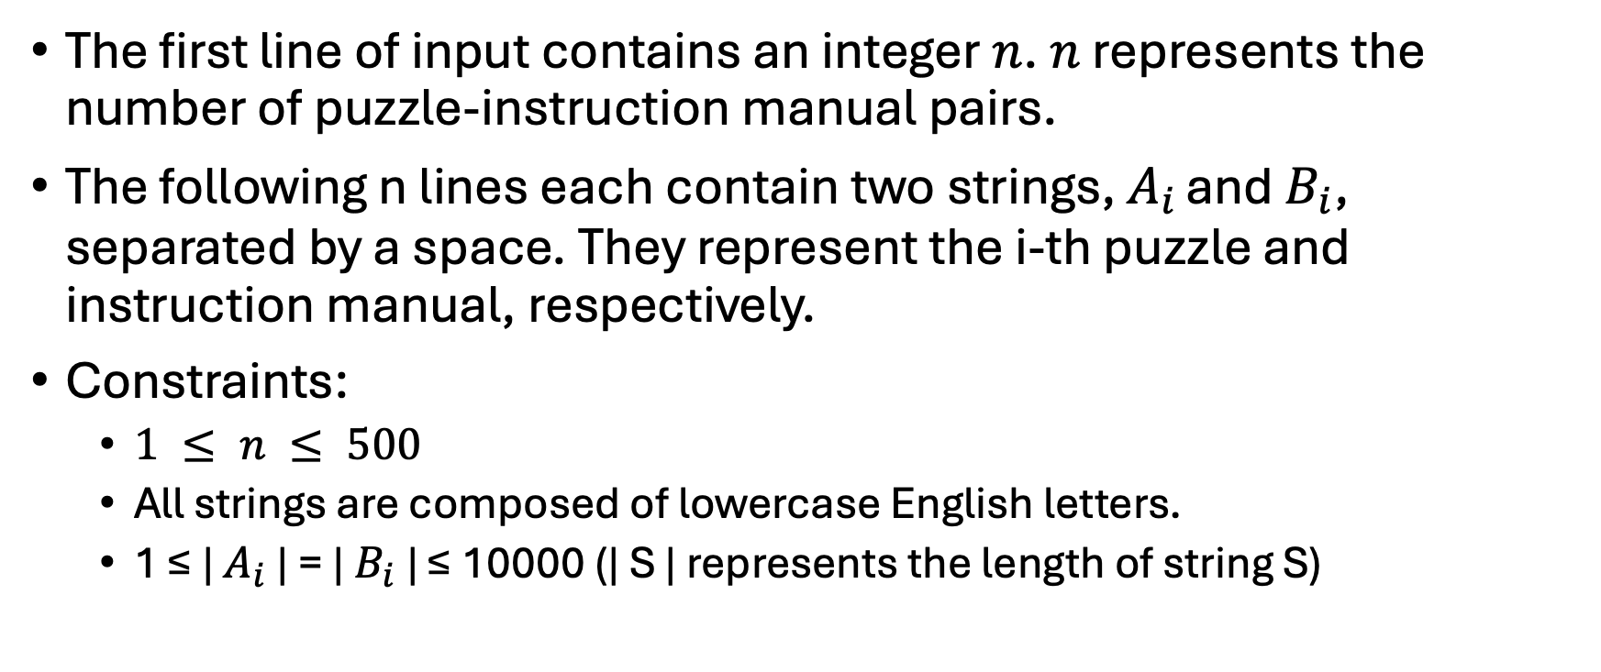
Input
The first line of input contains an integer $n$. $n$ represents the number of puzzle-instruction manual pairs.
The following n lines each contain two strings, $A_{i }$and $B_{i}$, separated by a space. They represent the i-th puzzle and instruction manual, respectively.
Constraints:
$1 ≤ n ≤ 500$
All strings are composed of lowercase English letters.
1 ≤ | $A_{i}$ | = | $B_{i}$ | ≤ 10000 (| S | represents the length of string S)

Slide 7
Output
Output a single integer representing the number of puzzle and instruction manual pairs that Orange Cat correctly matched.
Remember to print a ‘\n’ at the end of the output.

Slide 8
Outline
Description
Input & Output
Basic testcase
Subtasks
Concept & Code

Slide 9
Basic testcase
sample input
sample output
3
abc cba
aaa aab
qwe qwe
2

Slide 10
Basic testcase
abc cba
cba can be rearranged to: abc, acb, bac, bca, cab, cba
abc is what we want, so now ans = 1

Slide 11
Basic testcase
abc cba
cba can be rearranged to: abc, acb, bac, bca, cab, cba
abc is what we want, so now ans = 1
aaa aab
aab can be rearranged to: aab, aba, baa
It’s impossible to match “aaa”, so ans still = 1

Slide 12
Basic testcase
abc cba
cba can be rearranged to: abc, acb, bac, bca, cab, cba
abc is what we want, so now ans = 1
aaa aab
aab can be rearranged to: aab, aba, baa
It’s impossible to match “aaa”, so ans still = 1
qwe qwe
we don’t need any operation, “qwe” = “qwe”.
So the final ans = 2

Slide 13
Outline
Description
Input & Output
Basic testcase
Subtasks
Concept & Code

Slide 14
Subtask 1
n = 1
just for debugging (maybe)

Slide 15

Subtask 2
Characters within $A_{i}$ , $B_{i}$ are arranged in ascending lexicographic order.
What is “lexicographic order”?

Slide 16
Lexicographic order
Starting from the first position (leftmost)
Find the first character that differs.
The string with the smaller character at that position is considered lexicographically smaller.
define “small character”: smaller ascii code is smaller
ascii code ref: English, Chinese
This will be very important!
For example, 'abc' < 'abd' because the first differing letter 'c' < 'd'.

Slide 17
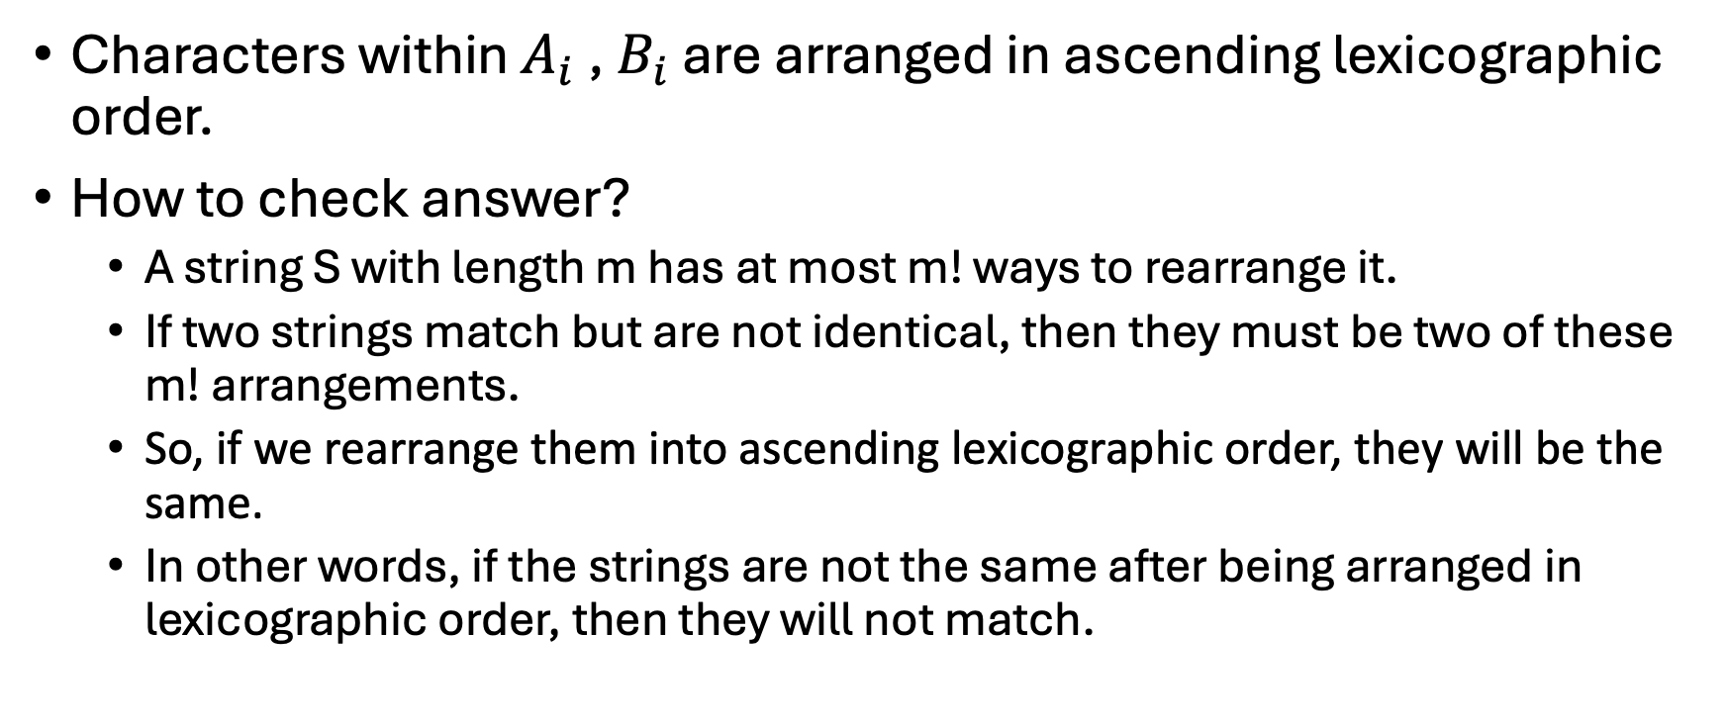
Subtask 2
Characters within $A_{i}$ , $B_{i}$ are arranged in ascending lexicographic order.
How to check answer?
A string S with length m has at most m! ways to rearrange it.
If two strings match but are not identical, then they must be two of these m! arrangements.
So, if we rearrange them into ascending lexicographic order, they will be the same.
In other words, if the strings are not the same after being arranged in lexicographic order, then they will not match.

Slide 18

Subtask 2
Characters within $A_{i}$ , $B_{i}$ are arranged in ascending lexicographic order.
Just compare whether two strings are the same or not!

Slide 19
Subtask 3
No additional restrictions
If two strings are not arranged in ascending lexicographic order, how can we determine if they match?
sort?
No, this is too complicated.

Slide 20
Subtask 3
No additional restrictions
If two strings are not arranged in ascending lexicographic order, how can we determine if they match?
Imagine you're going to build with LEGO. After you get the design plan, you need to collect the materials. How would you do this?
You would first count the quantity of each component, then collect them all at once.
Same as this problem!

Slide 21
Subtask 3
No additional restrictions
If two strings are not arranged in ascending lexicographic order, how can we determine if they match?
Count the occurrence of each character in string A
Then, scan string B from left to right, decrementing the count by 1 for each character encountered
Check if every character's count equals 0
Yes: ans++
No: skip

Slide 22
Outline
Description
Input & Output
Basic testcase
Subtasks
Concept & Code & Others

Slide 23
Concept
Calculate how many of each letter are needed
Verify if that quantity has been reached
Think further: What if the lengths of two strings are different?

Slide 24
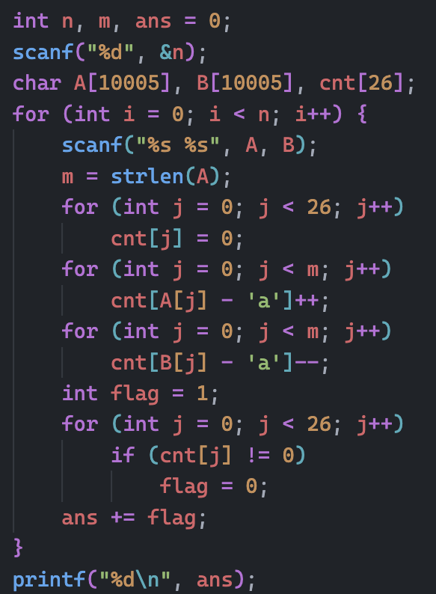
Code

Slide 25
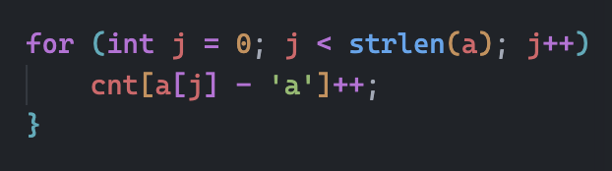
Got TLE?
Check if you have placed strlen() inside the loop
The time complexity of strlen(S) is |S|

Slide 26
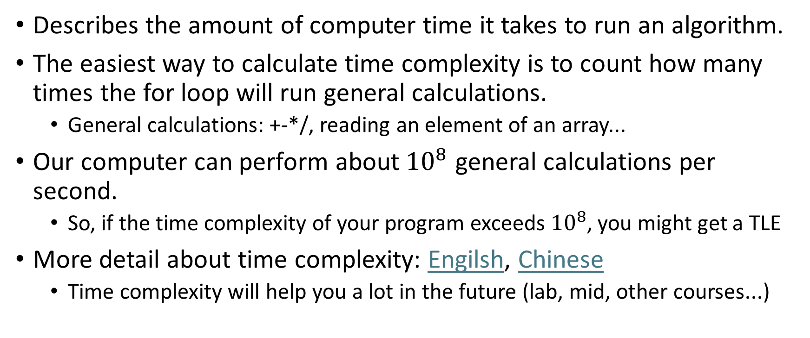
Time complexity
Describes the amount of computer time it takes to run an algorithm.
The easiest way to calculate time complexity is to count how many times the for loop will run general calculations.
General calculations: +-*/, reading an element of an array...
Our computer can perform about${10}^{8}$ general calculations per second.
So, if the time complexity of your program exceeds${ 10}^{8}$, you might get a TLE
More detail about time complexity: Engilsh, Chinese
Time complexity will help you a lot in the future (lab, mid, other courses...)

Slide 27

In this case
Your program’s time complexity will be O($500 ∗ {10000}^{2}$)
500 is the maxium value of n.
10000 is the maxium length of the input string
It may need about 10 minutes to finish your program.

Slide 28
Overall
Use an array to count some important information
Be careful of the time complexity of your program
Try to think about different situations of this problem
It might help you learn more

